Slide 1
CS 454: Software Engineering-3 Mobile Software Engineering Introduction to Mobile Computing

Slide 2
Software Engineering in Mobile Computing – MSE
Instructor:
Anas Youssef
Assistant Professor
Computer Science Department
Faculty of Computers & Information,Menoufia University
Email: anas.youssef@ci.menofia.edu.eg

Slide 3
Course Grading
Course work 40%
Assignment(s)
Quizzes
Presentation
Midterm
Term Project
Final Exam 60%

Slide 4
Course Link
http://www.acadox.com/join/NAWPM2
Course join code: NAWPM2

Slide 5
Course Outline
Mobile computing basics
Mobile operating systems (Android platform)
Mobile development software engineering models
Mobile applications architecture best practices
Mobile user interface design best practices
Mobile applications testing
Internet of Things

Slide 6
Introduction
This unit provides basic knowledge about mobile computing principles, characteristics and limitations.

Slide 7
Definition of Mobile Computing
Mobile computing systems are computing systems that may be easily moved physically and whose computing capabilities may be used while they are being moved
Examples of mobile computing systems are laptops, personal digital assistants (PDAs), and mobile phones

Slide 8
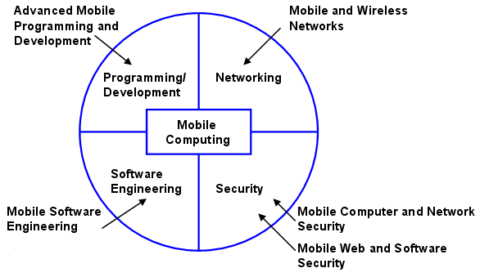
Core Areas in Mobile Computing
Uskov, Vladimir L. "Mobile software engineering in mobile computing curriculum." Interdisciplinary Engineering Design Education Conference (IEDEC), 2013 3rd. IEEE, 2013.

Slide 9
Software Engineering for Mobile Computing - MSE
The adaptive process of creating a software product that is intended to be used by people while they are mobile.
By this, the process must take into account the specific characteristics of mobile usage to deliver the required quality.

Slide 10
Characteristics of Mobile Computing Systems
Prevalent wireless network connectivity
Small size
Mobility
Limited power sources
Functionalities particularly suited to the mobile user

Slide 11
Is Wireless Mobile or Is Mobile Wireless?
There is a great source of confusion between wireless communications and mobile computing
Do ALL mobile computing devices need to be wireless?
Though it is not a requirement for a mobile system to be wireless, most mobile systems are wireless

Slide 12
Is Any System Actually Mobile?
There is probably no system that is truly not mobile because just about any system may be moved
A mobile system should be movable very easily by just one person

Slide 13
Components of Any Mobile System
There are four components:
mobile user
mobile device
mobile application
mobile network
The objective of this course is to solve the problem of architecting, designing, and implementing solutions for mobile computing problems

Slide 14
Distinction Between Mobile & Stationary Computing Systems
Location awareness
Context awareness
Network connectivity quality of service (QoS)
Limited device capabilities (particularly storage/CPU)
Limited power supply
Variety of user interfaces

Slide 15
Distinction Between Mobile & Stationary Computing Systems
Platform proliferation
Notification system importance
Security
Complexity of testing
User input Methods

Slide 16
Location Awareness
Location sensitivity is the ability of the device and the software application to
first obtain location information while being used and
take advantage of this location information in offering features and functionality
The user may simply be prompted for his or her location, but this wouldn’t make a very user-friendly application

Slide 17
Context Awareness
Context sensitivity is the ability of the device and the software application to
Collect useful information from the surrounding environment
Notify user about this information

Slide 18
Network Connectivity QoS
In the case of wireless network connectivity, physical conditions can significantly affect the quality of service QoS
For example, bad weather and a variety of other climate-related conditions can negatively affect QoS
Mobile applications should know how to stop working when the application suddenly disconnects from the network and then resume working when it connects again

Slide 19
Limited Device Capabilities
Physical size limitation imposes boundaries on volatile storage, nonvolatile storage, and CPU on mobile devices
Today’s mobile applications are resource-starved
Limitations of storage and CPU of mobile devices put constraints on how to develop mobile applications
For example, a mobile calendaring application may store some of its data on another node on the network (a PC, server, etc.)

Slide 20
Limited Power Supply
Most power management functionality is built into the operating system of the mobile device
Therefore, the design focus is more on making the right choice in selecting the proper platform (device, operating system, etc.) and configuring the platform properly

Slide 21
Varying User Interfaces
Designers and implementers of mobile applications must understand the necessity of finding the best user interface(s) for the application
Designers must architect the system to accommodate the suitable user interface(s), implementing them, and keeping in mind that a new user interface may be required at any time

Slide 22
Platform Proliferation
Mobile devices are small and there is much less hardware in them than in a PC, therefore, more manufacturers can compete in producing these devices
This leads to proliferation of different types of devices in the marketplace that an application must support
Platform proliferation heightens the importance of designing and developing devices independent of the platform
Writing native code specific to the mobile device, unless absolutely necessary because of performance requirements, is not a recommended practice because of the proliferation of devices

Slide 23
Notification System
A fast and accurate notification system should be supported in mobile systems
Mobile users are not always focused and need to be always notified about their email accounts, calendar events, etc…

Slide 24
Security
Most embedded devices are “closed”, in the sense that there is no straightforward way to attack the embedded software and affect its operation
Mobile platforms are open, allowing the installation of new “malware” applications that can affect the overall operation of the device.

Slide 25
Testing Complexity
Testing mobile apps is a very tedious process since many scenarios should be tested.
For example, testing location-aware and context-aware apps requires testing in different locations and in different contexts.
In-lab emulator tests, In-lab target device tests, real environment tests

Slide 26
User Input Methods
Sensor handling – most smartphones, include
accelerometer that responds to device movement,
touch screen that responds to numerous gestures
real and/or virtual keyboards
global positioning system (GPS)
microphone
one or more cameras
multiple networking protocols

Slide 27
Mobile User vs Stationary User
The mobile user is fundamentally different from the stationary user in the following ways:
moving, at least occasionally, between known or unknown locations
typically not focused on the computing task
frequently requires high degrees of responsiveness from the system changing tasks frequently and/or abruptly
require access to the system anywhere and at any time

Slide 28
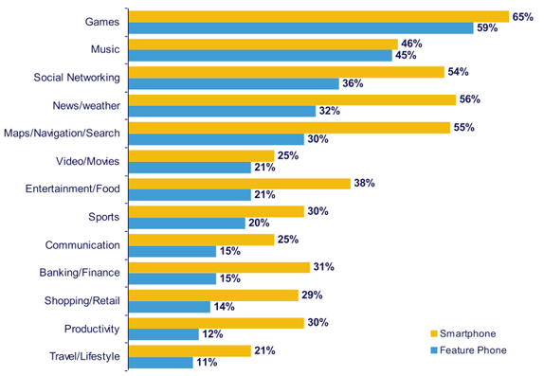
Popular Downloaded Mobile Apps
“The State of Mobile Apps” report by Nielsenwire, http://blog.nielsen.com/nielsenwire/online_mobile/thestate- of-mobile-apps

Slide 29
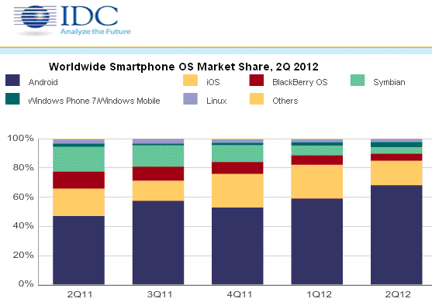
Popular Mobile Operating Systems
"Worldwide Quarterly Mobile Phone Tracker" report by IDC, http://www.vdcresearch.com/index.aspx

Slide 30
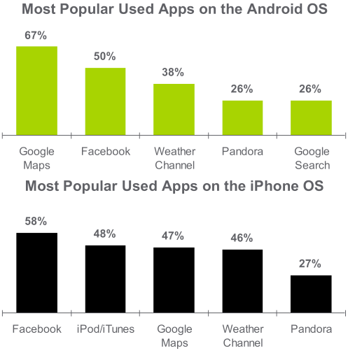
Popular Apps on Android & iOS
“The State of Mobile Apps” report by Nielsenwire, http://blog.nielsen.com/nielsenwire/online_mobile/thestate- of-mobile-apps

Slide 31
References
Chapter1 – “Mobile Computing Principles: Designing and Developing Mobile Applications with UML and XML,” Reza B'Far, Cambridge University Press; (November 1, 2004)

Slide 32
Thank you for
your attention.

